Slide 1

Introduction: Themes in the Study of Life

Slide 2

Overview: Inquiring About the World of Life
Evolution is the process of change that has transformed life on Earth
Biology is the scientific study of life
Biologists ask questions such as:
How a single cell develops into an organism
How the human mind works
How living things interact in communities
Copyright © 2008 Pearson Education, Inc., publishing as Pearson Benjamin Cummings

Slide 3

Life defies a simple, one-sentence definition
Life is recognized by what living things do
Copyright © 2008 Pearson Education, Inc., publishing as Pearson Benjamin Cummings
Notes:
Click to add notes

Slide 4
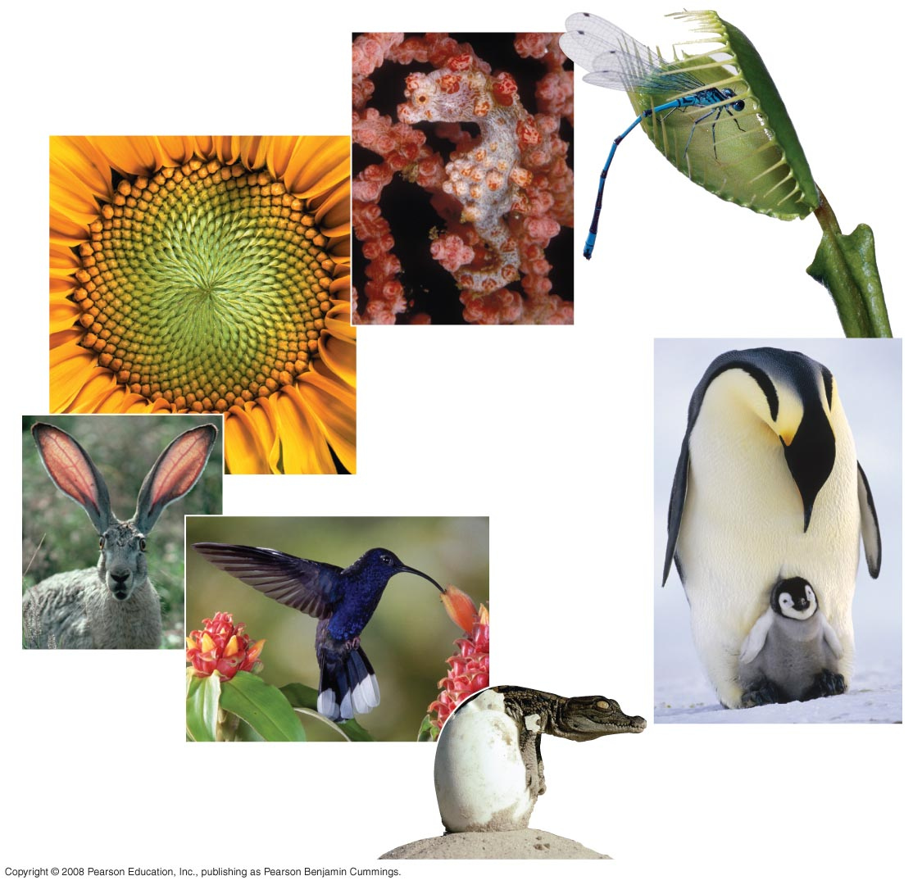

Fig. 1-3
Order
Response
to the
environment
Evolutionary adaptation
Regulation
Reproduction
Energy
processing
Growth and
development
Notes:
Figure 1.3 Some properties of life

Slide 5
Evolution, the Overarching Theme of Biology
Evolution makes sense of everything we know about living organisms
Organisms living on Earth are modified descendents of common ancestors
Copyright © 2008 Pearson Education, Inc., publishing as Pearson Benjamin Cummings

Slide 6
Theme: New properties emerge at each level in the biological hierarchy
Life can be studied at different levels from molecules to the entire living planet
The study of life can be divided into different levels of biological organization
Copyright © 2008 Pearson Education, Inc., publishing as Pearson Benjamin Cummings

Slide 7
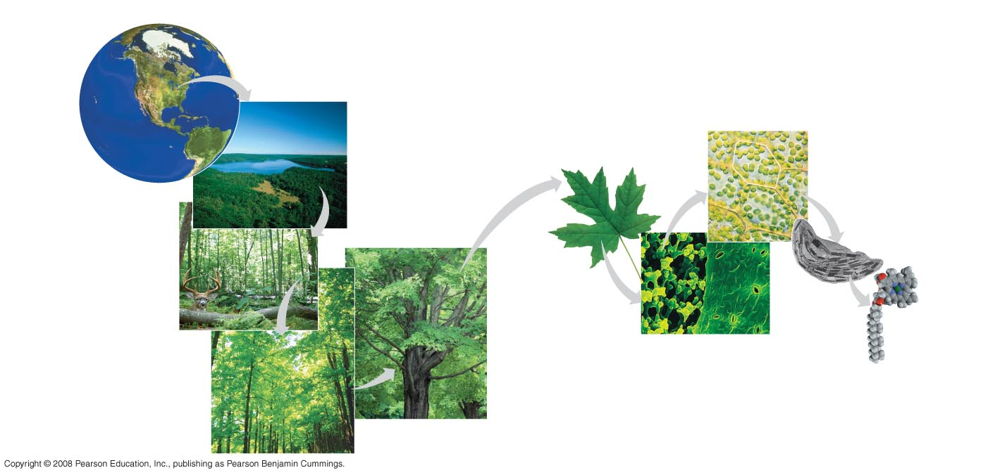
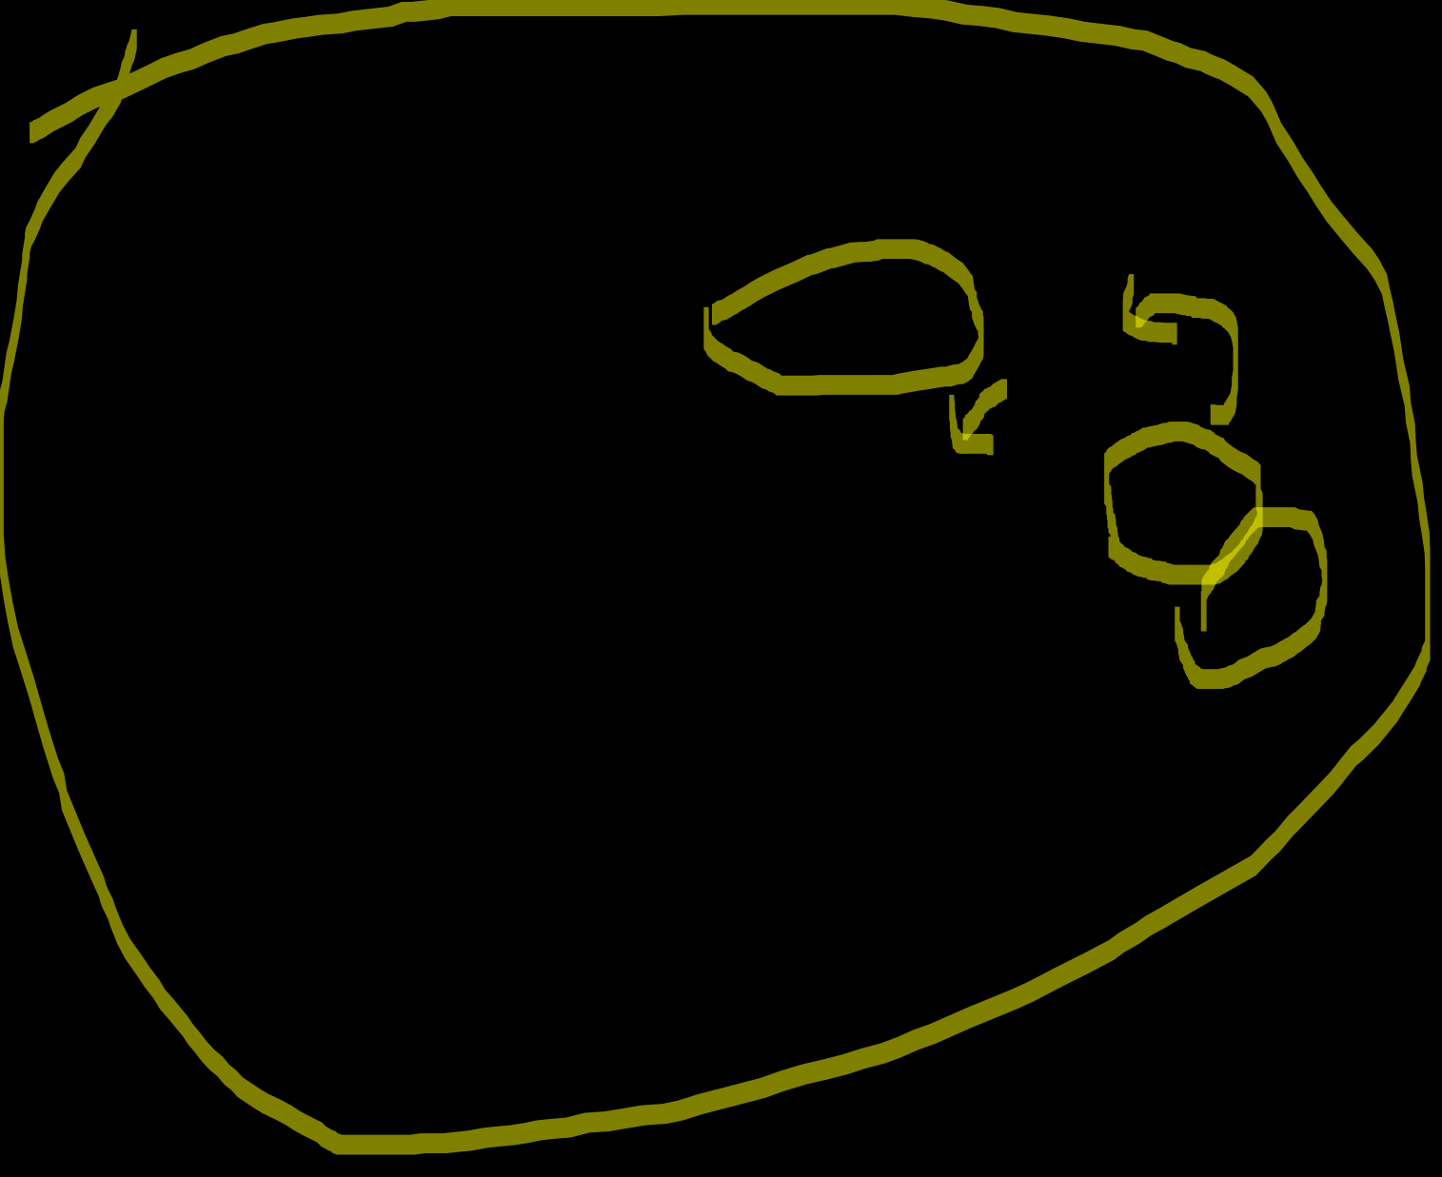
Fig. 1-4
The biosphere
Cells
Organs and organ systems
10 µm
Cell
Ecosystems
Organelles
Communities
1 µm
Atoms
Tissues
50 µm
Populations
Molecules
Organisms
Notes:
Figure 1.4 Levels of biological organization

Slide 8
Emergent Properties
Emergent properties result from the arrangement and interaction of parts within a system
Emergent properties characterize nonbiological entities as well
For example, a functioning bicycle emerges only when all of the necessary parts connect in the correct way
Copyright © 2008 Pearson Education, Inc., publishing as Pearson Benjamin Cummings

Slide 9
The Power and Limitations of Reductionism
Reductionism is the reduction of complex systems to simpler components that are more manageable to study
For example, the molecular structure of DNA
An understanding of biology balances reductionism with the study of emergent properties
For example, new understanding comes from studying the interactions of DNA with other molecules
Copyright © 2008 Pearson Education, Inc., publishing as Pearson Benjamin Cummings

Slide 10

Systems Biology
A system is a combination of components that function together
Systems biology constructs models for the dynamic behavior of whole biological systems
The systems approach poses questions such as:
How does a drug for blood pressure affect other organs?
How does increasing CO₂ alter the biosphere?
Copyright © 2008 Pearson Education, Inc., publishing as Pearson Benjamin Cummings

Slide 11
Theme: Organisms interact with their environments, exchanging matter and energy
Every organism interacts with its environment, including nonliving factors and other organisms
Both organisms and their environments are affected by the interactions between them
For example, a tree takes up water and minerals from the soil and carbon dioxide from the air; the tree releases oxygen to the air and roots help form soil
Copyright © 2008 Pearson Education, Inc., publishing as Pearson Benjamin Cummings

Slide 12

Ecosystem Dynamics
The dynamics of an ecosystem include two major processes:
Cycling of nutrients, in which materials acquired by plants eventually return to the soil
The flow of energy from sunlight to producers to consumers
Copyright © 2008 Pearson Education, Inc., publishing as Pearson Benjamin Cummings

Slide 13
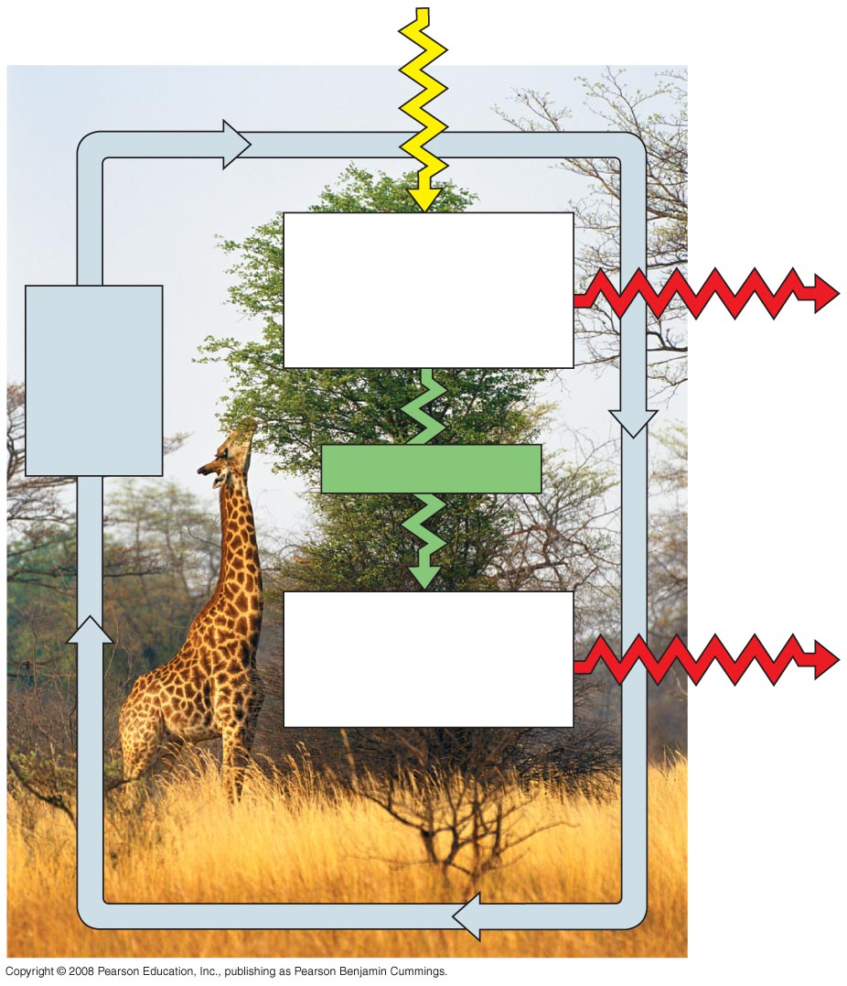
Fig. 1-5
Sunlight
Ecosystem
Producers
(plants and other photosynthetic
organisms)
Cycling
of
chemical
nutrients
Heat
Chemical energy
Consumers
(such as animals)
Heat
Notes:
Figure 1.5 Nutrient cycling and energy flow in an ecosystem

Slide 14
Energy Conversion
Work requires a source of energy
Energy can be stored in different forms, for example, light, chemical, kinetic, or thermal
The energy exchange between an organism and its environment often involves energy transformations
Energy flows through an ecosystem, usually entering as light and exiting as heat
Copyright © 2008 Pearson Education, Inc., publishing as Pearson Benjamin Cummings

Slide 15
Theme: Structure and function are correlated at all levels of biological organization
Structure and function of living organisms are closely related
For example, a leaf is thin and flat, maximizing the capture of light by chloroplasts
Copyright © 2008 Pearson Education, Inc., publishing as Pearson Benjamin Cummings

Slide 16

Theme: Cells are an organism’s basic units of structure and function
The cell is the lowest level of organization that can perform all activities required for life
All cells:
Are enclosed by a membrane
Use DNA as their genetic information
The ability of cells to divide is the basis of all reproduction, growth, and repair of multicellular organisms
Copyright © 2008 Pearson Education, Inc., publishing as Pearson Benjamin Cummings

Slide 17

A eukaryotic cell has membrane-enclosed organelles, the largest of which is usually the nucleus
By comparison, a prokaryotic cell is simpler and usually smaller, and does not contain a nucleus or other membrane-enclosed organelles
Bacteria and Archaea are prokaryotic; plants, animals, fungi, and all other forms of life are eukaryotic
Copyright © 2008 Pearson Education, Inc., publishing as Pearson Benjamin Cummings

Slide 18
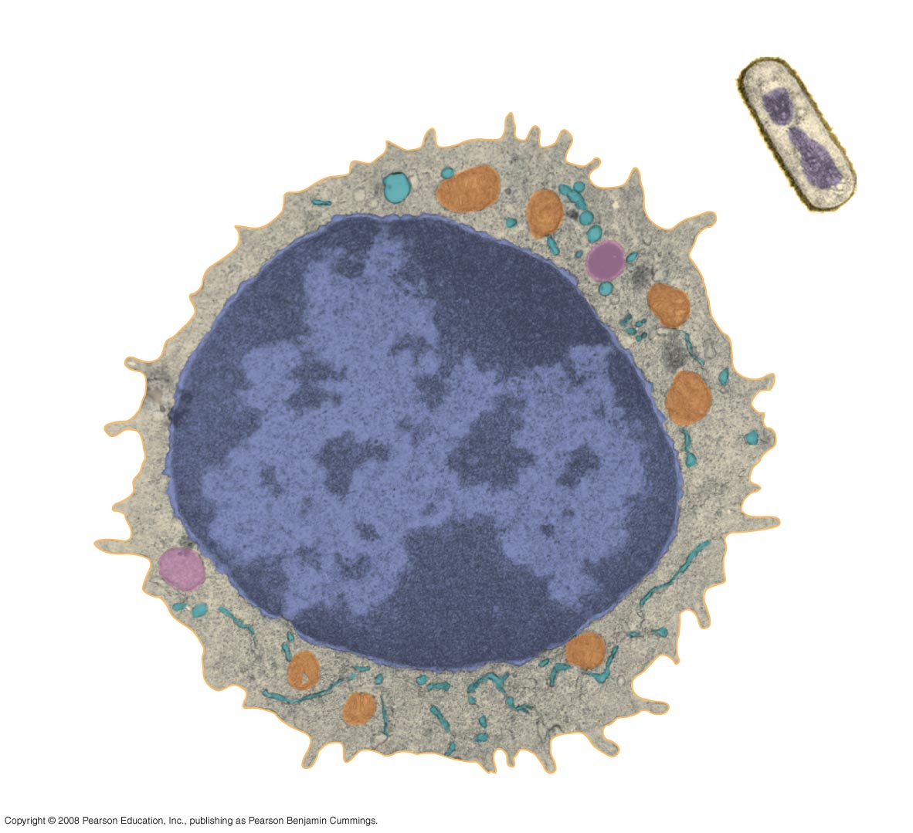

Fig. 1-8
Prokaryotic cell
Eukaryotic cell
DNA
(no nucleus)
Membrane
Membrane
Cytoplasm
Organelles
Nucleus (contains DNA)
1 µm
Notes:
Figure 1.8 Contrasting eukaryotic and prokaryotic cells in size and complexity

Slide 19

Theme: The continuity of life is based on heritable information in the form of DNA
Chromosomes contain most of a cell’s genetic material in the form of DNA (deoxyribonucleic acid)
DNA is the substance of genes
Genes are the units of inheritance that transmit information from parents to offspring
Copyright © 2008 Pearson Education, Inc., publishing as Pearson Benjamin Cummings

Slide 20

DNA Structure and Function
Each chromosome has one long DNA molecule with hundreds or thousands of genes
DNA is inherited by offspring from their parents
DNA controls the development and maintenance of organisms
Copyright © 2008 Pearson Education, Inc., publishing as Pearson Benjamin Cummings

Slide 21
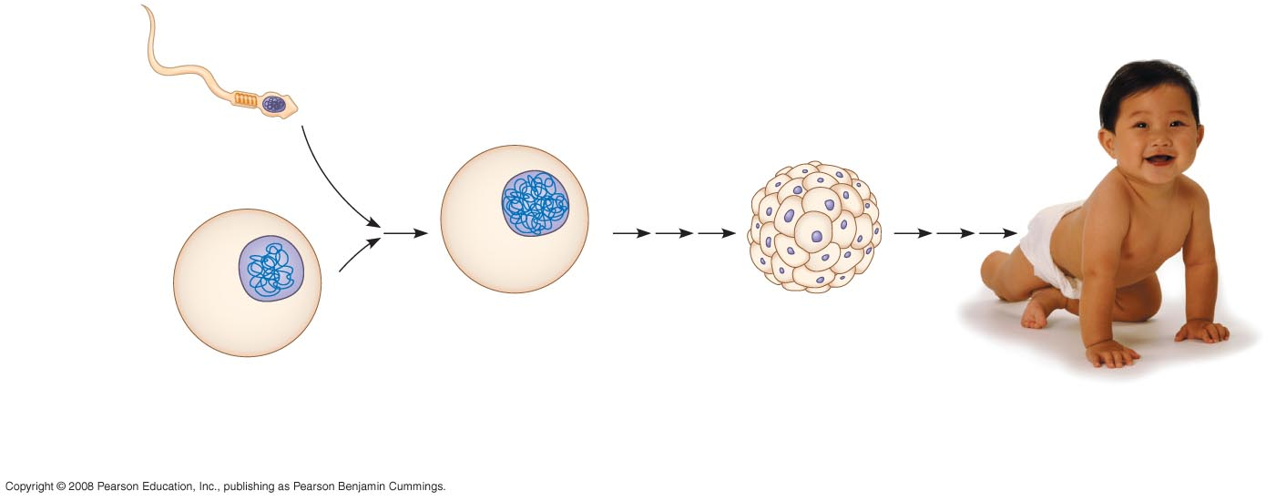

Fig. 1-9
Sperm cell
Nuclei
containing
DNA
Fertilized egg
with DNA from
both parents
Embryo’s cells with
copies of inherited DNA
Egg cell
Offspring with traits
inherited from
both parents
Notes:
Figure 1.9 Inherited DNA directs development of an organism

Slide 22
Each DNA molecule is made up of two long chains arranged in a double helix
Each link of a chain is one of four kinds of chemical building blocks called nucleotides
Copyright © 2008 Pearson Education, Inc., publishing as Pearson Benjamin Cummings

Slide 23
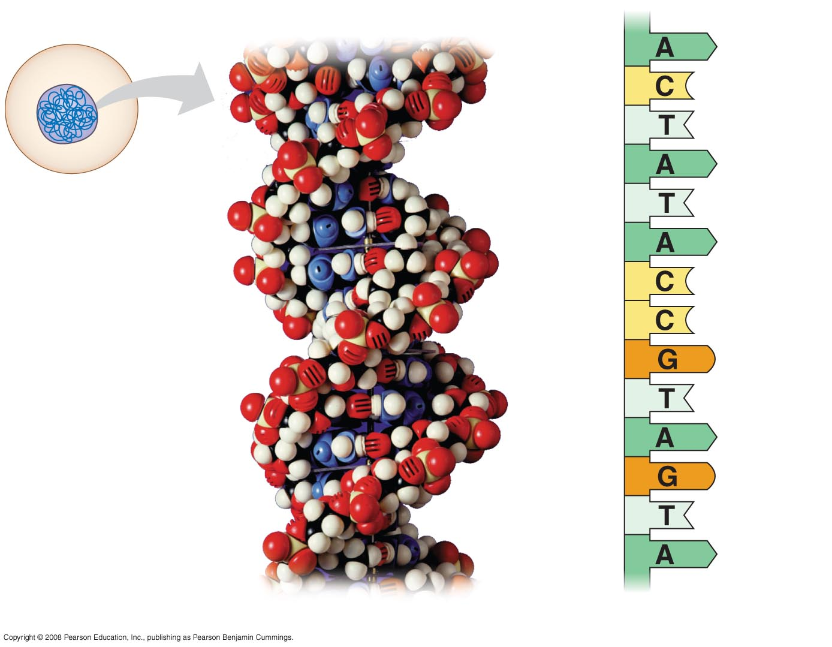

Fig. 1-10
Nucleus
DNA
Nucleotide
Cell
(a) DNA double helix
(b) Single strand of DNA
Notes:
Figure 1.10 DNA: The genetic material

Slide 24

Genes control protein production indirectly
DNA is transcribed into RNA then translated into a protein
An organism’s genome is its entire set of genetic instructions
Copyright © 2008 Pearson Education, Inc., publishing as Pearson Benjamin Cummings

Slide 25

Systems Biology at the Levels of Cells and Molecules
The human genome and those of many other organisms have been sequenced using DNA-sequencing machines
Knowledge of a cell’s genes and proteins can be integrated using a systems approach
Copyright © 2008 Pearson Education, Inc., publishing as Pearson Benjamin Cummings

Slide 26
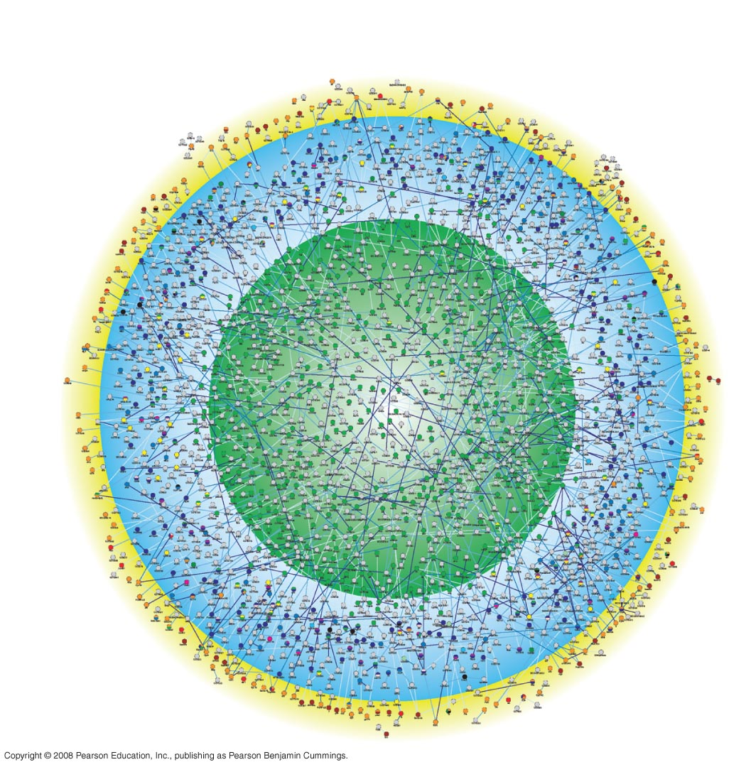
Fig. 1-12
Outer membrane
and cell surface
Cytoplasm
Nucleus
Notes:
Figure 1.12 A systems map of interactions among proteins in a cell

Slide 27

Advances in systems biology at the cellular and molecular level depend on
“High-throughput” technology, which yields enormous amounts of data
Bioinformatics, which is the use of computational tools to process a large volume of data
Interdisciplinary research teams
Copyright © 2008 Pearson Education, Inc., publishing as Pearson Benjamin Cummings

Slide 28

Theme: Feedback mechanisms regulate biological systems
Feedback mechanisms allow biological processes to self-regulate
Negative feedback means that as more of a product accumulates, the process that creates it slows and less of the product is produced
Positive feedback means that as more of a product accumulates, the process that creates it speeds up and more of the product is produced
Copyright © 2008 Pearson Education, Inc., publishing as Pearson Benjamin Cummings

Slide 29
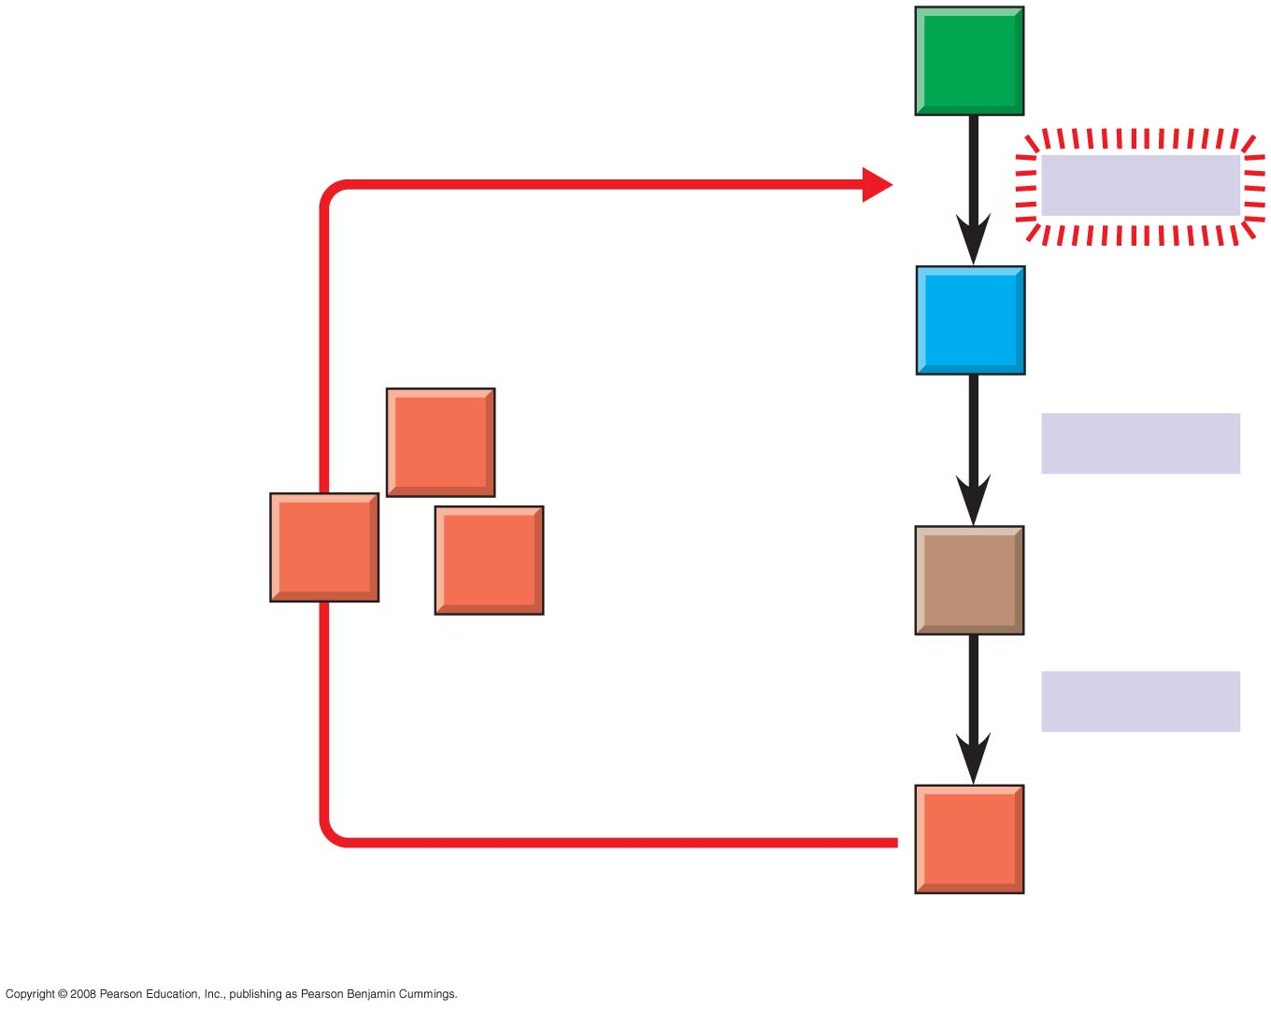

Fig. 1-13a
A
Negative
feedback
–
Enzyme 1
B
D
Enzyme 2
Excess D
blocks a step
D
D
C
Enzyme 3
D
(a) Negative feedback
Notes:
Figure 1.13 Regulation by feedback mechanisms

Slide 30

Organizing the Diversity of Life
Approximately 1.8 million species have been identified and named to date, and thousands more are identified each year
Estimates of the total number of species that actually exist range from 10 million to over 100 million
Copyright © 2008 Pearson Education, Inc., publishing as Pearson Benjamin Cummings

Slide 31

Grouping Species: The Basic Idea
Taxonomy is the branch of biology that names and classifies species into groups of increasing breadth
Domains, followed by kingdoms, are the broadest units of classification
Copyright © 2008 Pearson Education, Inc., publishing as Pearson Benjamin Cummings

Slide 32
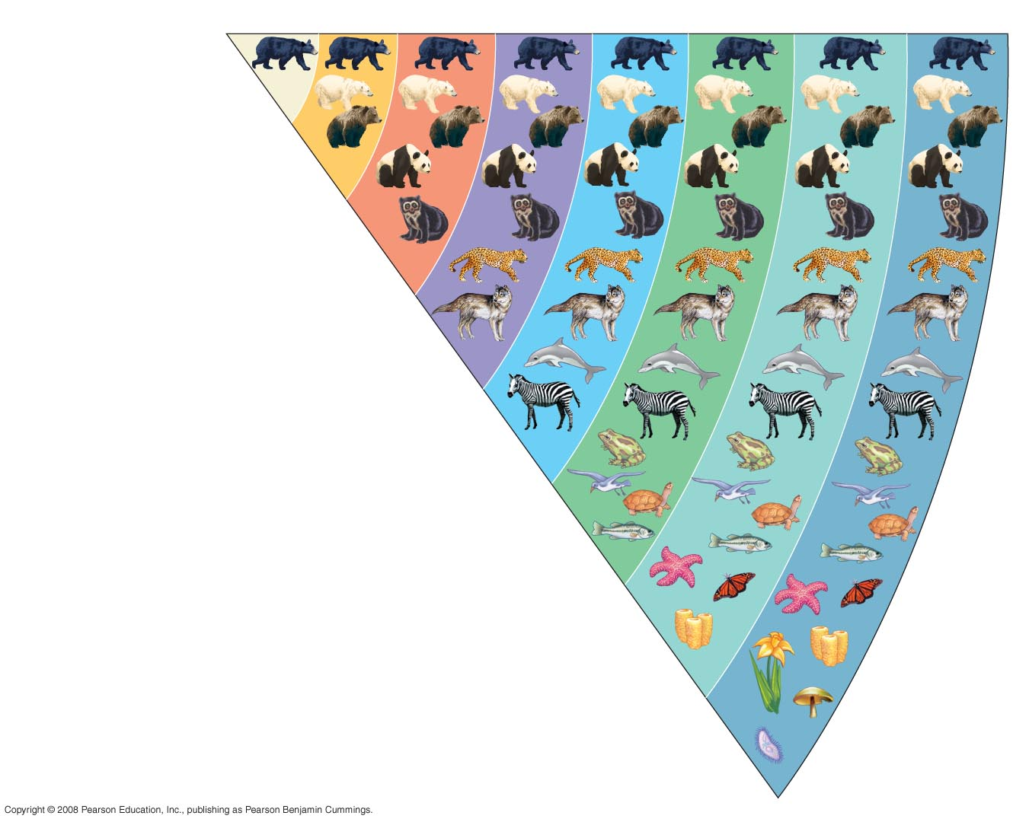

Fig. 1-14
Species
Genus
Family
Order
Class
Phylum
Kingdom
Domain
Ursus americanus
(American black bear)
Ursus
Ursidae
Carnivora
Mammalia
Chordata
Animalia
Eukarya
Notes:
Figure 1.14 Classifying life

Slide 33

The Three Domains of Life
The three-domain system is currently used, and replaces the old five-kingdom system
Domain Bacteria and domain Archaea comprise the prokaryotes
Domain Eukarya includes all eukaryotic organisms
Copyright © 2008 Pearson Education, Inc., publishing as Pearson Benjamin Cummings

Slide 34
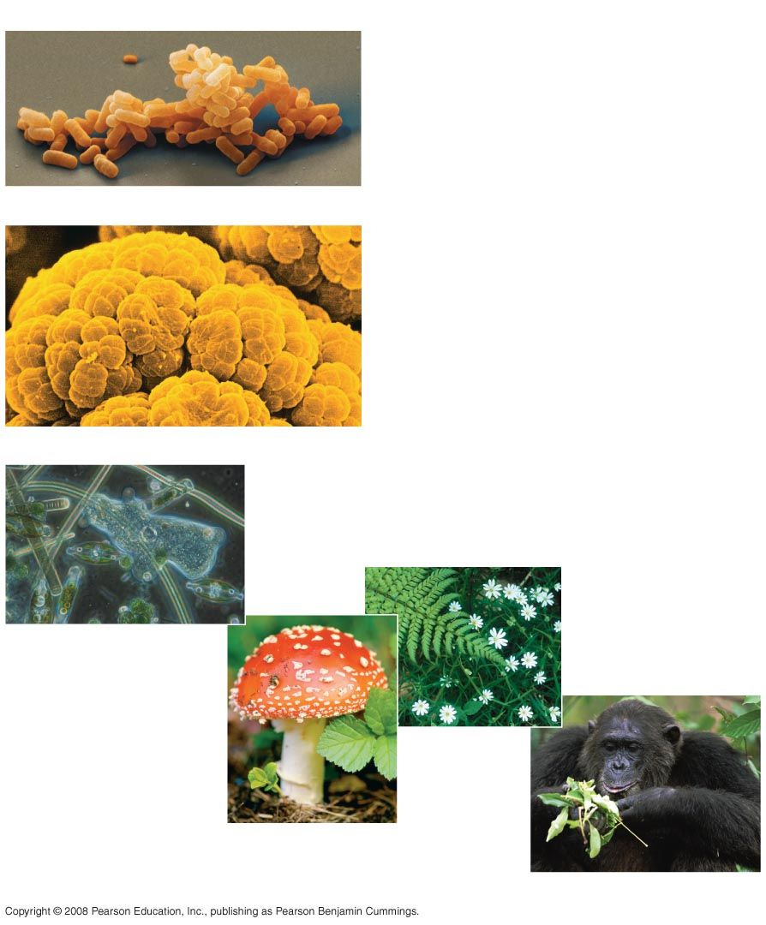

Fig. 1-15
(a) DOMAIN BACTERIA
(b) DOMAIN ARCHAEA
(c) DOMAIN EUKARYA
Protists
Kingdom
Plantae
Kingdom Fungi
Kingdom Animalia
Notes:
Figure 1.15 The three domains of life

Slide 35

The domain Eukarya includes three multicellular kingdoms:
Plantae
Fungi
Animalia
Other eukaryotic organisms were formerly grouped into a kingdom called Protista, though these are now often grouped into many separate kingdoms
Copyright © 2008 Pearson Education, Inc., publishing as Pearson Benjamin Cummings

Slide 36
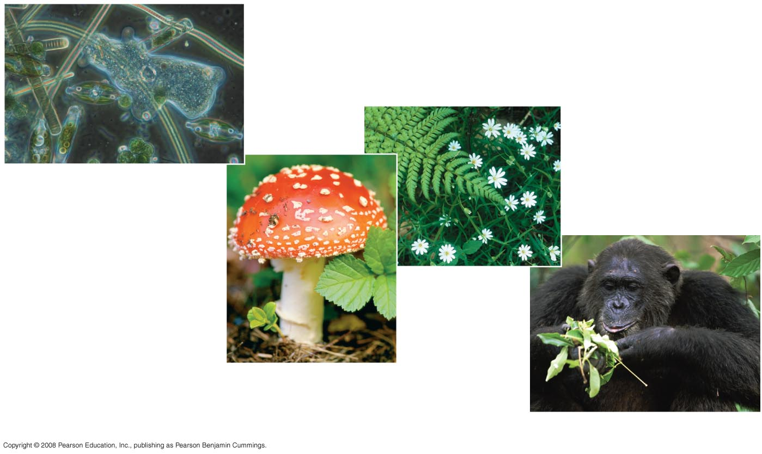
Fig. 1-15c
Protists
Kingdom Plantae
Kingdom Fungi
(c) DOMAIN EUKARYA
Kingdom Animalia
Notes:
Figure 1.15 The three domains of life

Slide 37
Unity in the Diversity of Life
A striking unity underlies the diversity of life; for example:
DNA is the universal genetic language common to all organisms
Unity is evident in many features of cell structure
Copyright © 2008 Pearson Education, Inc., publishing as Pearson Benjamin Cummings

Slide 38
Charles Darwin and the Theory of Natural Selection
Fossils and other evidence document the evolution of life on Earth over billions of years
Copyright © 2008 Pearson Education, Inc., publishing as Pearson Benjamin Cummings

Slide 39

Charles Darwin published On the Origin of Species by Means of Natural Selection in 1859
Darwin made two main points:
Species showed evidence of “descent with modification” from common ancestors
Natural selection is the mechanism behind “descent with modification”
Darwin’s theory explained the duality of unity and diversity
Copyright © 2008 Pearson Education, Inc., publishing as Pearson Benjamin Cummings

Slide 40

Darwin observed that:
Individuals in a population have traits that vary
Many of these traits are heritable (passed from parents to offspring)
More offspring are produced than survive
Competition is inevitable
Species generally suit their environment
Copyright © 2008 Pearson Education, Inc., publishing as Pearson Benjamin Cummings

Slide 41

Darwin inferred that:
Individuals that are best suited to their environment are more likely to survive and reproduce
Over time, more individuals in a population will have the advantageous traits
In other words, the natural environment “selects” for beneficial traits
Copyright © 2008 Pearson Education, Inc., publishing as Pearson Benjamin Cummings

Slide 42
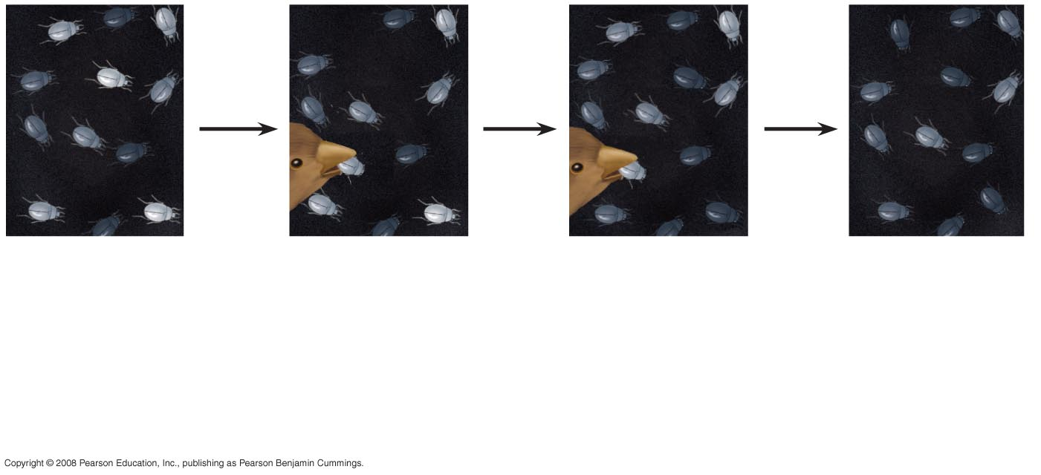

Fig. 1-20
1
Population
with varied
inherited traits.
2
Elimination
of individuals
with certain
traits.
3
Reproduction
of survivors.
4
Increasing
frequency
of traits that enhance survival and reproductive success.
Notes:
Figure 1.20 Natural selection

Slide 43

Types of Data
Data are recorded observations or items of information
Data fall into two categories
Qualitative, or descriptions rather than measurements
Quantitative, or recorded measurements, which are sometimes organized into tables and graphs
Copyright © 2008 Pearson Education, Inc., publishing as Pearson Benjamin Cummings

Slide 44

Induction in Discovery Science
Inductive reasoning draws conclusions through the logical process of induction
Repeat specific observations can lead to important generalizations
For example, “the sun always rises in the east”
Copyright © 2008 Pearson Education, Inc., publishing as Pearson Benjamin Cummings

Slide 45
Hypothesis-Based Science
Observations can lead us to ask questions and propose hypothetical explanations called hypotheses
Copyright © 2008 Pearson Education, Inc., publishing as Pearson Benjamin Cummings

Slide 46
The Role of Hypotheses in Inquiry
A hypothesis is a tentative answer to a well-framed question
A scientific hypothesis leads to predictions that can be tested by observation or experimentation
Copyright © 2008 Pearson Education, Inc., publishing as Pearson Benjamin Cummings

Slide 47
For example,
Observation: Your flashlight doesn’t work
Question: Why doesn’t your flashlight work?
Hypothesis 1: The batteries are dead
Hypothesis 2: The bulb is burnt out
Both these hypotheses are testable
Copyright © 2008 Pearson Education, Inc., publishing as Pearson Benjamin Cummings

Slide 48

Deduction: The “If…Then” Logic of Hypothesis Based Science
Deductive reasoning uses general premises to make specific predictions
For example, if organisms are made of cells (premise 1), and humans are organisms (premise 2), then humans are composed of cells (deductive prediction)
Copyright © 2008 Pearson Education, Inc., publishing as Pearson Benjamin Cummings

Slide 49

A Closer Look at Hypotheses in Scientific Inquiry
A hypothesis must be testable and falsifiable
Hypothesis-based science often makes use of two or more alternative hypotheses
Failure to falsify a hypothesis does not prove that hypothesis
For example, you replace your flashlight bulb, and it now works; this supports the hypothesis that your bulb was burnt out, but does not prove it (perhaps the first bulb was inserted incorrectly)
Copyright © 2008 Pearson Education, Inc., publishing as Pearson Benjamin Cummings

Slide 50
The Myth of the Scientific Method
The scientific method is an idealized process of inquiry
Hypothesis-based science is based on the “textbook” scientific method but rarely follows all the ordered steps
Discovery science has made important contributions with very little dependence on the so-called scientific method
Copyright © 2008 Pearson Education, Inc., publishing as Pearson Benjamin Cummings

Slide 51
Designing Controlled Experiments
A controlled experiment compares an experimental group (the artificial kingsnakes) with a control group (the artificial brown snakes)
Ideally, only the variable of interest (the color pattern of the artificial snakes) differs between the control and experimental groups
A controlled experiment means that control groups are used to cancel the effects of unwanted variables
A controlled experiment does not mean that all unwanted variables are kept constant
Copyright © 2008 Pearson Education, Inc., publishing as Pearson Benjamin Cummings

Slide 52
Limitations of Science
In science, observations and experimental results must be repeatable
Science cannot support or falsify supernatural explanations, which are outside the bounds of science
Copyright © 2008 Pearson Education, Inc., publishing as Pearson Benjamin Cummings

Slide 53

Theories in Science
In the context of science, a theory is:
Broader in scope than a hypothesis
General, and can lead to new testable hypotheses
Supported by a large body of evidence in comparison to a hypothesis
Copyright © 2008 Pearson Education, Inc., publishing as Pearson Benjamin Cummings

Slide 54

Model Building in Science
Models are representations of natural phenomena and can take the form of:
Diagrams
Three-dimensional objects
Computer programs
Mathematical equations
Copyright © 2008 Pearson Education, Inc., publishing as Pearson Benjamin Cummings

Slide 55
Science, Technology, and Society
The goal of science is to understand natural phenomena
The goal of technology is to apply scientific knowledge for some specific purpose
Science and technology are interdependent
Biology is marked by “discoveries,” while technology is marked by “inventions”
Copyright © 2008 Pearson Education, Inc., publishing as Pearson Benjamin Cummings

Slide 56
The combination of science and technology has dramatic effects on society
For example, the discovery of DNA by James Watson and Francis Crick allowed for advances in DNA technology such as testing for hereditary diseases
Ethical issues can arise from new technology, but have as much to do with politics, economics, and cultural values as with science and technology
Copyright © 2008 Pearson Education, Inc., publishing as Pearson Benjamin Cummings

Slide 57
You should now be able to:
Briefly describe the unifying themes that characterize the biological sciences
Distinguish among the three domains of life, and the eukaryotic kingdoms
Distinguish between the following pairs of terms: discovery science and hypothesis-based science, quantitative and qualitative data, inductive and deductive reasoning, science and technology
Copyright © 2008 Pearson Education, Inc., publishing as Pearson Benjamin Cummings

